Slide 1


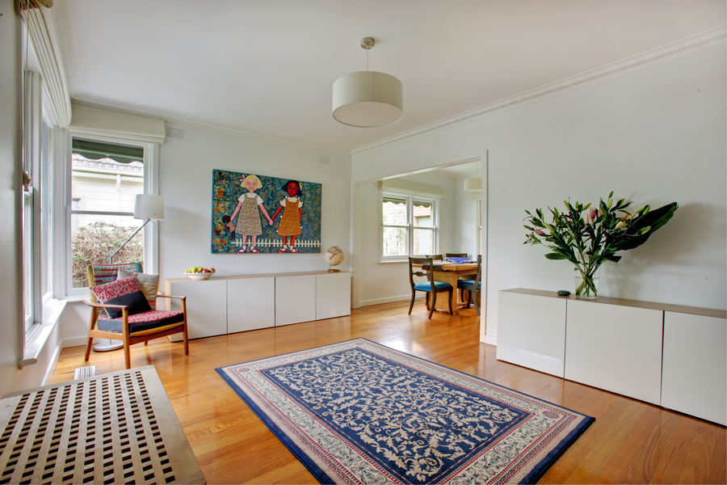
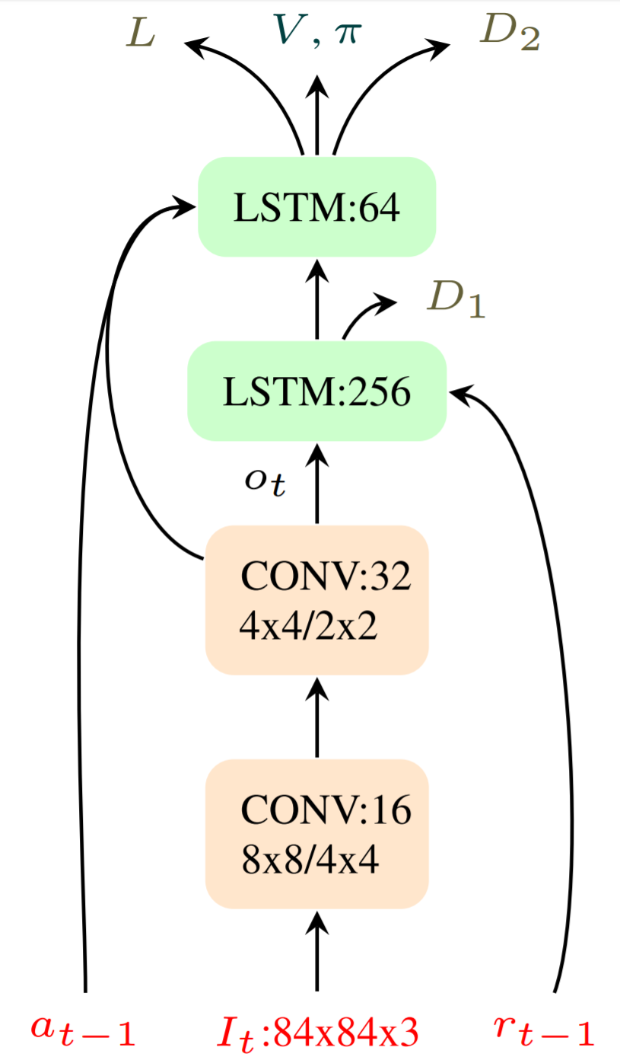
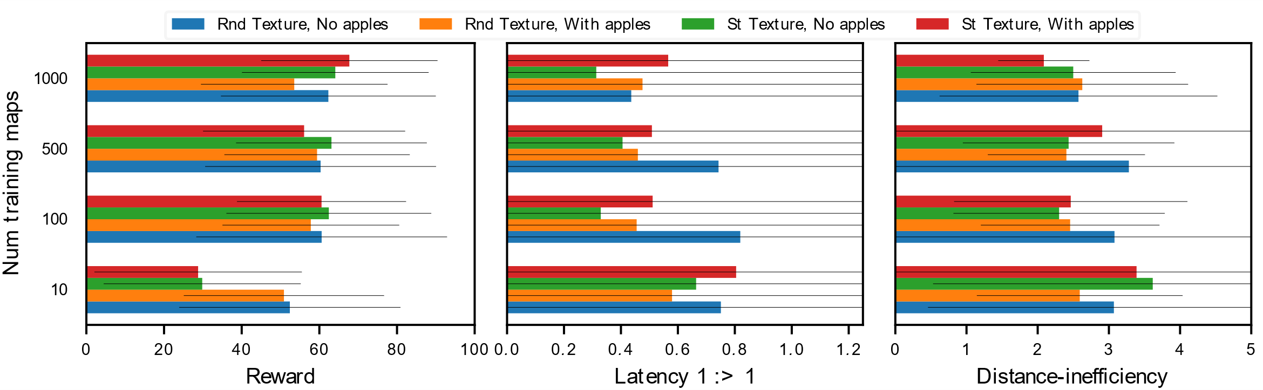

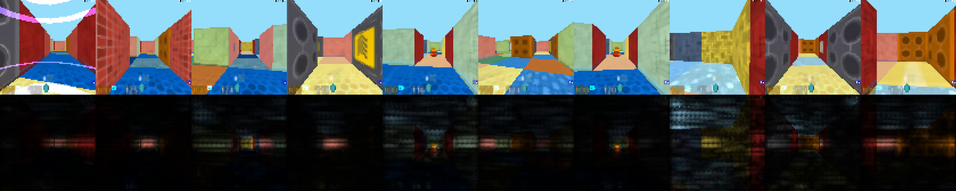
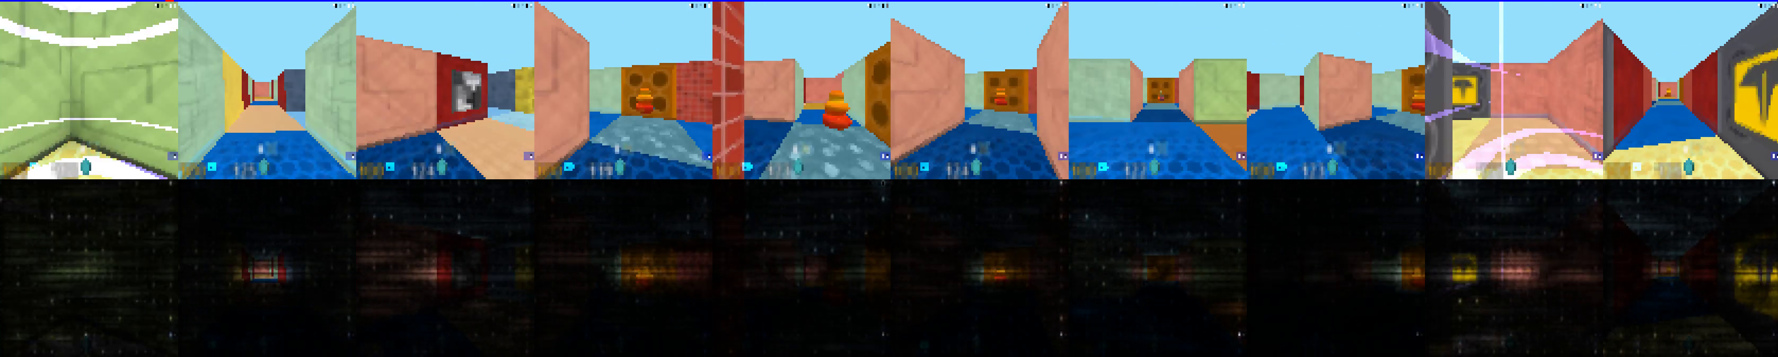
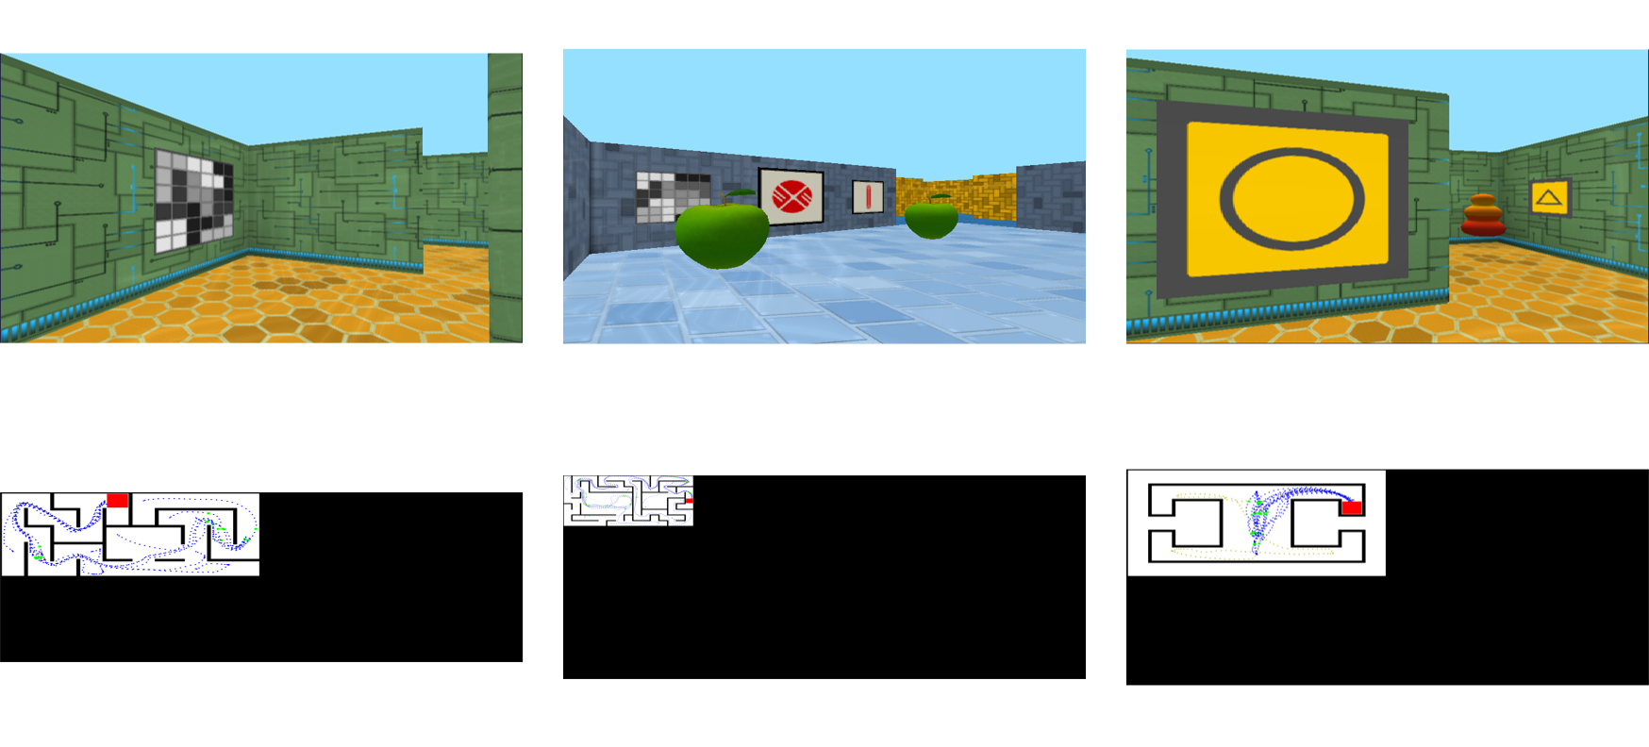
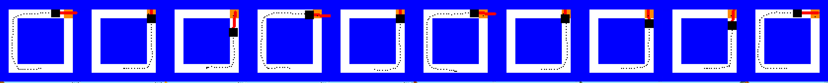
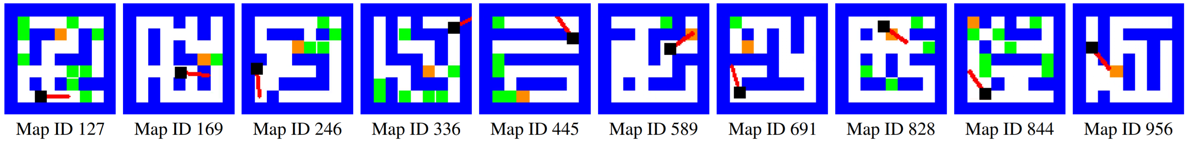
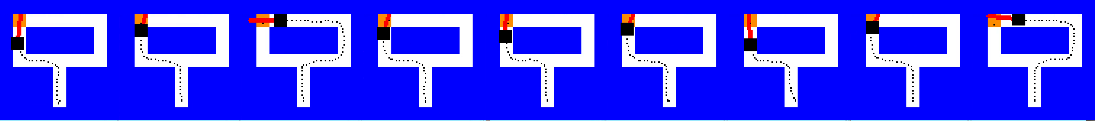
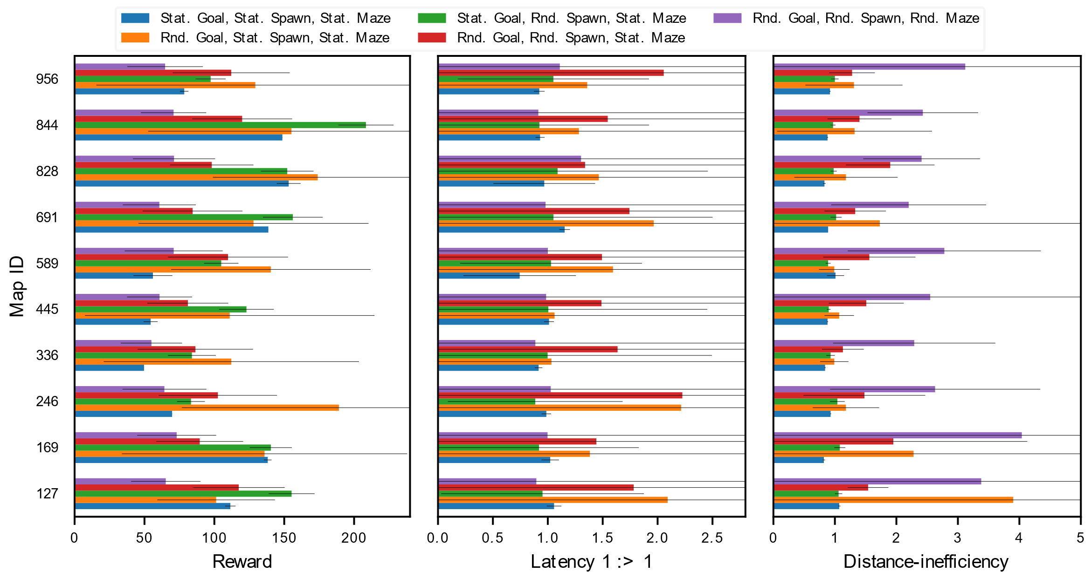
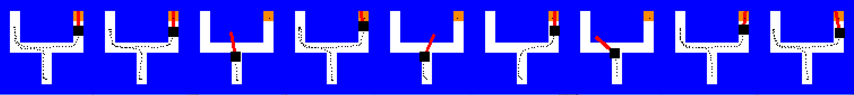
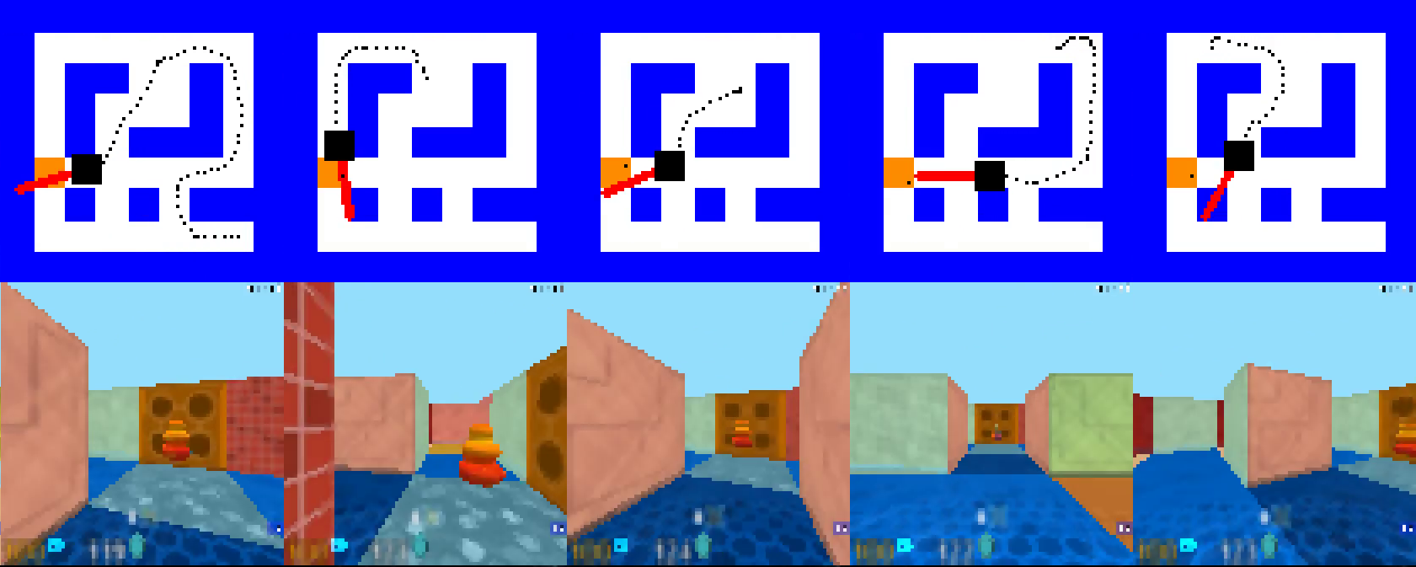
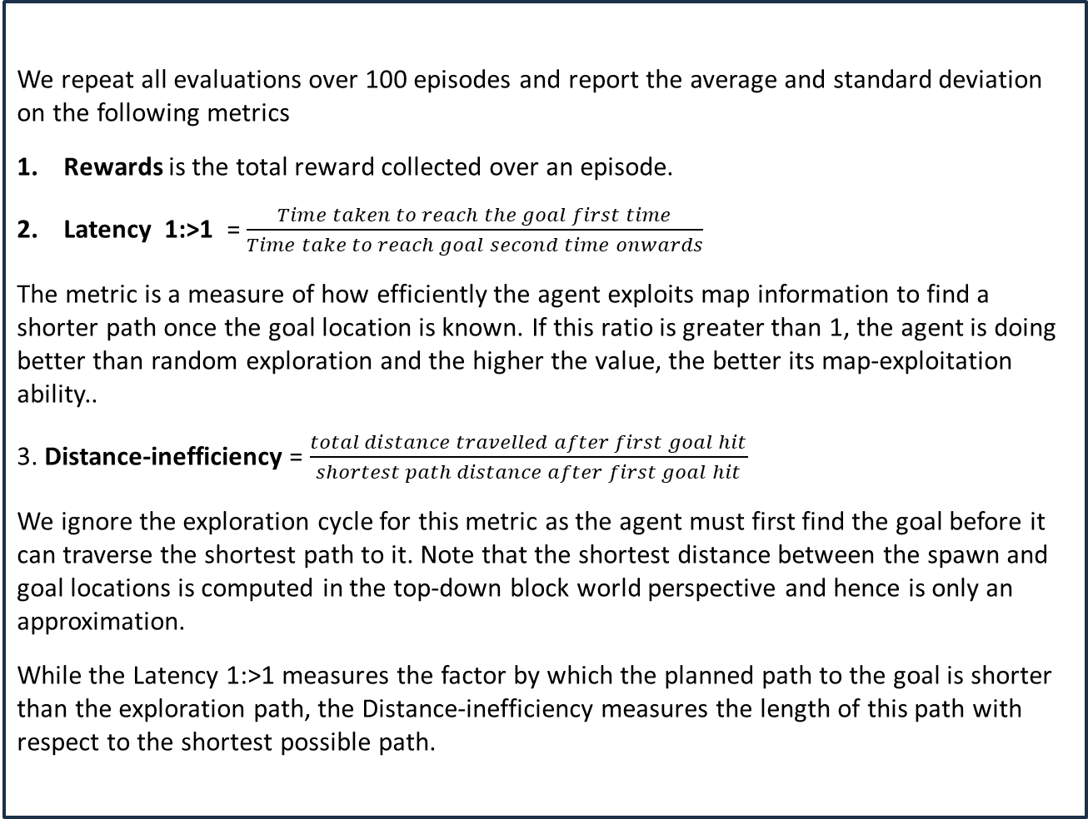
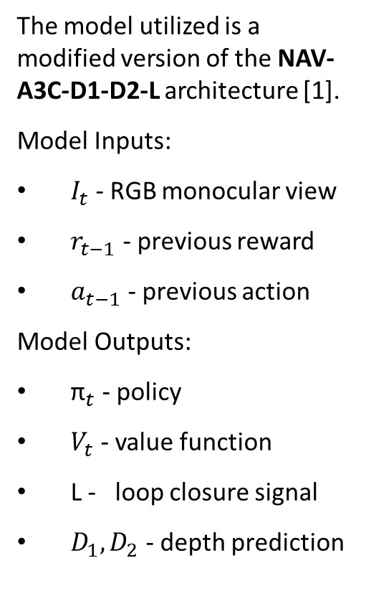
Do deep reinforcement learning algorithms really learn to navigate?
2017 NSF NRI PI MEETING Project IIS 1522904: RobotSLANG
Shurjo Banerjee*, Vikas Dhiman*, Brent Griffin and Jason J. Corso
Electrical Engineering and Computer Science, University of Michigan, Ann Arbor, MI
{shurjo,dhiman,griffb,jjcorso}@umich.edu
What does it mean to navigate?
Network architecture
Evaluation metrics
Unseen maps and effects of apples and texture
Where is the Kitchen? (Mapping)
Where am I relative to Kitchen? (Localization)
What is the shortest path to Kitchen? (Path-planning)
How do I execute the shortest path? (Control)
The model utilized is a modified version of the NAV-A3C-D1-D2-L architecture [1].
Model Inputs:
$I_{t}$ - RGB monocular view
$r_{t−1}$ - previous reward
$a_{t−1}$ - previous action
Model Outputs:
${\text{π}}_{t}$ - policy
$V_{t}$ - value function
L - loop closure signal
$D_{1},D_{2}$ - depth prediction
We repeat all evaluations over 100 episodes and report the average and standard deviation on the following metrics
Rewards is the total reward collected over an episode.
Latency 1:>1 = $\frac{Time taken to reach the goal first time}{Time take to reach goal second time onwards}$
The metric is a measure of how efficiently the agent exploits map information to find a shorter path once the goal location is known. If this ratio is greater than 1, the agent is doing better than random exploration and the higher the value, the better its map-exploitation ability..
3. Distance-inefficiency = $\frac{total distance travelled after first goal hit}{shortest path distance after first goal hit}$
We ignore the exploration cycle for this metric as the agent must first find the goal before it can traverse the shortest path to it. Note that the shortest distance between the spawn and goal locations is computed in the top-down block world perspective and hence is only an approximation.
While the Latency 1:>1 measures the factor by which the planned path to the goal is shorter than the exploration path, the Distance-inefficiency measures the length of this path with respect to the shortest possible path.
Fig 4. Plots showing the effect of number of training maps with random textures (Rnd Textures) and the presence of apples (With apples) when evaluated on unseen maps. We note that the difference between mean metrics is negligible when their standard deviations are taken in to account. The effect of apples or textures can thus be ignored. The only clear trend can be seen in the Latency 1:>1 metric which suggests that random textures without apples is the most advantageous for agents to exploit goal location information.
Attention maps
The DRL Navigation Challenge
We randomly generate 1000 training maps and 100 testing maps for our experiments. We perform systematic experiments with increasing difficulty.
Learning to navigate (Mirowski et al 2017)
Static goal, static spawn, static maze. All three goal location, spawn location and maze are static during training and testing.
Static goal, random spawn, static maze. This problem is more difficult than previous case because the agent must find an optimal policy to the goal from each possible starting point in the maze. The spawn location is different for each spawn during an episode.
3. Random goal, static spawn, static maze. We choose a random goal location for each episode, but the goal location stays constant throughout an episode. The agent can perform well on this experiment by remembering the goal
location after it has been discovered and exploiting the information to revisit the goal faster.
4. Random goal, random spawn, static maze. This is the problem that is addressed by Mirowski et al (2017) with limited success. They evaluate this case on two maps and report Latency 1:>1 to be greater than 1 in one of the two maps. We evaluate the same metric on ten other maps.
5. Random goal, random spawn, random maze. We test DRL algorithms on unseen maps like other machine learning algorithms.
Fig 5. Visualizing attention for two sequences. The first two rows show the sequence when the model is trained on and evaluated on the same map. The last two rows shows the sequence for a model trained on 1000 maps and evaluated on one of the maps. We observe that the attention is uniformly distributed on the image when the agent spawns. The attention narrows down few pixels in the center when the agent is navigating through the corridor. It spreads to the entire image around turns and junctions. The algorithm also pays close attention to important objects like goal, apples and unique decals
Qualitative results
Quantitative results
Do DRL really learns to navigate?
1. Do DRL algorithms perform mapping and path-planning when evaluated on unseen maps?
2. Do DRL algorithms perform shortest path planning when trained and tested on the same maps?
3. If yes, in what cases do they perform shortest path planning?
Fig 4. Snapshots of path taken by the agent to reach the goal in a single episode when model trained on 1000 maps is evaluated Square, Wrench and Goal map. The top row shows an evaluation example on Square map, the agent takes the shortest path 6/10 times but when averaged over 100 episodes, the percentage of shortest path taken is not better than random 50.4% (±12.8%). Although for the example of Wrench map the agent takes the shortest path 8/10 times but when averaged over 100 episodes, the percentage of shortest path taken is reduced to 32.9% (±25.1%). For the Goal map, the example chosen here shows that the shortest path is only taken 1/6 times, on an average over 100 episodes, the shortest path is taken 42.6% (±35.1%) times. Agents thus appear to be unable to generalize learned navigational abilities to unseen maps and perform better-than-random exploration.
Environment setup
Conclusions
1. To answer the do DRL-based navigation algorithms really ``learn to navigate‘’? Our results answer this question negatively.
2. At best, we can say that DRL-based algorithms learn to navigate in the training environment, rather than learning any general techniques of navigation which is what classical mapping and path planning algorithms provide.
References
[1] Piotr Mirowski, Razvan Pascanu, Fabio Viola, Hubert Soyer, Andrew J. Ballard, Andrea Banino, Misha Denil, Ross Goroshin, Laurent Sifre, Koray Kavukcuoglu, Dharshan Kumaran, and Raia Hadsell. Learning to navigate in complex environments. CoRR, abs/1611.03673, 2016. URL http://arxiv.org/abs/1611.03673
[2] Charles Beattie, Joel Z Leibo, Denis Teplyashin, Tom Ward, Marcus Wainwright, Heinrich Küttler, Andrew Lefrancq, Simon Green, Víctor Valdés, Amir Sadik, et al. Deepmind lab. arXiv preprint arXiv:1612.03801, 2016.
Fig 1. Screen shots from Deepmind lab environment.
Fig 2. We evaluate the Nav-A3C+D_1D_2L algorithm on ten randomly chosen maps with increasing difficulty. The vertical axis is one of the ten map ID's on which the agent was trained (except for Rnd. Maze) and evaluated. The horizontal axis are the different evaluation metrics. We note that when the goal is static the rewards are consistently higher as compared to randomized goals. With static goals, the metric Distance-inefficiency is close to 1, indicating that the algorithms are able to find the shortest path. However, with random goals, the agents struggle to find the shortest path. From the Latency 1:>1 results we note that the algorithm does well when trained and tested on the same map but fails to generalize to new maps when evaluated on the ability to exploit information about the goal location. Also note that Latency 1:>1 metric for cases of static goals is expected to be close to one because the location of goal is learned at train time.
Fig 1. The objective is to find goal as many times as possible within an episode of fixed length (1200 steps). After each goal hit, the agent gets respawned at the spawn location which can be random or static. The mazes are randomly generated and the simulation environment of Deepmind Lab [2] is used for implementation.
Acknowledgements
This work was partially supported by the NSR NRI IIS 1522904 and NSF CNS 1463102.

Slide 2
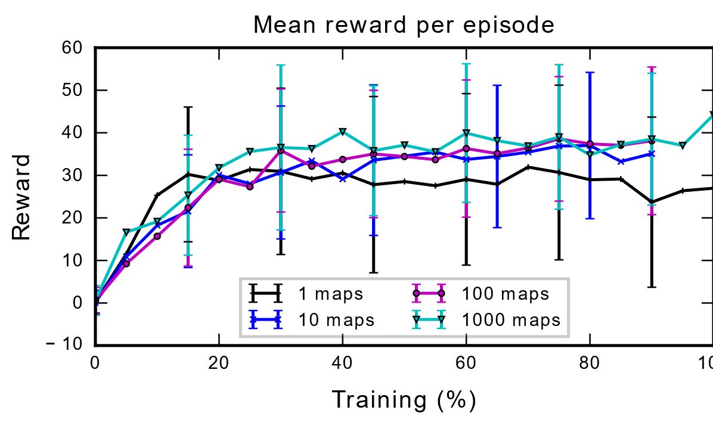
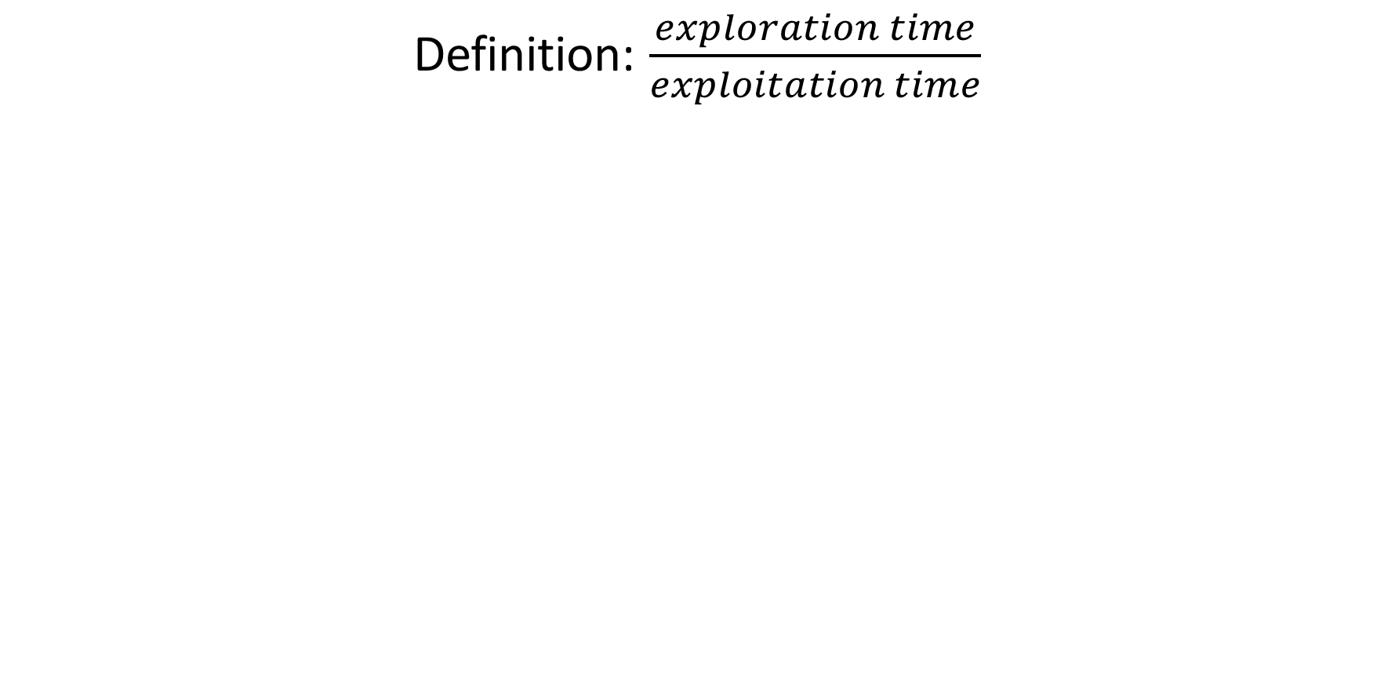
Where is the Kitchen? (Mapping)
Where am I relative to Kitchen? (Localization)
What is the shortest path to Kitchen? (Path-planning)
How do I execute the shortest path? (Control)
Objective and Contributions
We empirically analyze Mirowski et. al’s (2016) NAV-A3C-D1-D2-L deep reinforcement learning method for navigation across a wide variety of environments and starting conditions and discover that learned navigational abilities do not generalize to previously unseen environments.
Motivations:
DRL-based navigation methods have demonstrated strong performance in learning to find a goal in challenging environments.
It is unknown whether agents thus trained are performing any path-planning or mapping in their navigation.
Contributions:
Empirical analysis of this method across a wide variety of environments and starting conditions.
Empirical analysis of the performance of this method on previously unseen environments.
Coincident Training/Testing Sets (Static Maps):
10 maps are randomly selected from the training set.
Agents are trained and tested on the same map under differing starting conditions:
static goal, static spawn
static goal, random spawn
The experiments analyze how well agent’s can remember and exploit goal location information in explored environments
Separated Training/Testing Sets (Random Maps):
Agents are trained on increasing subsets {1, 10, 100, 500, 1000} of the training set and tested on the testing set.
The experiments analyze whether these learned navigational abilities extend to unknown environments.
In recent years, deep reinforcement learning for navigation has arisen as a potential alternative to SLAM methods. Unlike SLAM, it combines the tasks of exploration and mapping in to a single learning framework.
Agents are trained on pure vision based monocular input. The model utilized is a modified version of the NAV-A3C-D1-D2-L architecture.
random goal, static spawn
random goal, random spawn
Evaluation Metrics
Latency 1:>1
Distance Inefficiency
Definition: $\frac{exploration time}{exploitation time}$
Problem Statement

